Slide 1
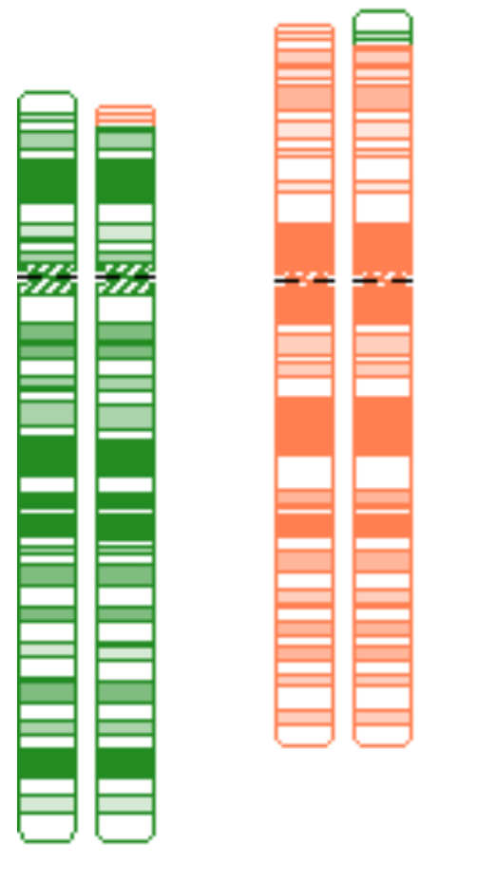
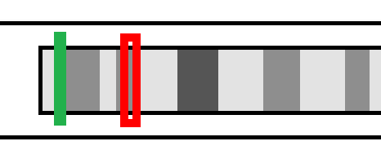
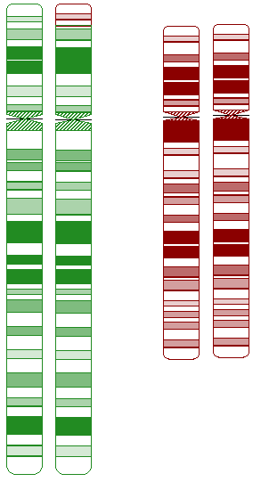
Laboratory Utilization Management System Assists with Familial Cytogenetic Testing: 3 Case Examples
Amanda S. Openshaw¹, Rachel M. Lasher¹, Michelle Q. Bosworth¹, Danielle LaGrave¹, Hiba Risheg¹, Bo Hong^{1,2}
¹ARUP Laboratories, Salt Lake City, UT; ²Department of Pathology, University of Utah, Salt Lake City, UT
Background
Case 1
Laboratory genetic counselors (GCs) in cytogenetics oversee a utilization management (UM) system to review the indication-specific appropriateness of incoming test orders, which saves both time and healthcare resources. This is especially important for families with a history of a genetic abnormality, since appropriate testing methodology may vary both between and within families. The UM process occurs in phases to maximize the efficiency and expertise of UM team members. Laboratory GC support specialists escalate cases with unclear or inappropriate indications based on a guideline developed by GCs and reviewed by medical directors. GCs then evaluate the escalated test orders and request proband reports when indicated. If the indication references a previous genetic study, GCs, cytogenetics supervisors, and/or medical directors evaluate the case to offer the correct test for accurate recurrence risk counseling. We describe 3 inappropriate orders for familial testing that were identified and corrected as a result of the UM process at ARUP Laboratories.
This series highlights the benefits of a routine laboratory UM system for familial cytogenetic testing and the nuances of such testing when cryptic copy number variants (CNVs) are involved.
Test: Blood chromosome analysis on adult female
Original Indication: “Exceptionally large newborn baby”
Flagged during UM review, corrected after inquiry
Corrected Indication: “Family history of a balanced translocation”
(Patient was pregnant at the time of testing (33w5d), and had previously delivered a large newborn)
Proband report was requested
Chromosome analysis would not detect the cytogenetically cryptic regions of interest.
Familial Report (summarized)
Sibling of Pt
Indication: Child with unbalanced t(5;6) by microarray
Test: Chromosome analysis
Result: 46,XY,t(5;6)(p15.31;p25.1)
Interpretation: Chromosome analysis was requested but required confirmation by subtelomeric FISH due to the small size of the regions involved. This sample shows an apparently balanced translocation involving chromosomes 5 and 6, at breakpoints 5p15.31 and 6p25.1.
NOTE: Since the abnormality is very subtle, it cannot be visualized well by routine chromosome analysis. Any at-risk family members should be tested by subtelomeric FISH.
Familial Translocation
Case Summary
Original order of chromosome analysis was an incorrect test for this patient
Not all balanced translocations can be identified by chromosome analysis
5
der(5)
6
der(6)
Case 2
Test: Blood chromosome analysis on reproductive partners
Indication: Child with 1p36 deletion by array, rule out balanced rearrangement in parents
Flagged by laboratory GC support specialists due to family history
GCs requested proband report
Neither karyotype nor the standard 1p36 FISH probe could detect the 1.4 Mb deletion
Testing was changed to custom FISH (results: de novo in proband)
Familial Report (summarized)
Result: 1.4 Mb loss at 1p36.23 (female)
Interpretation: Microarray showed a 1.4 Mb interstitial deletion of 16 genes which overlaps a proximal critical region for 1p36 deletion syndrome and is consistent with this diagnosis. This condition has been described with interstitial deletions. Features of 1p36 deletion syndrome include….
Conclusions
Case Summary
Original order of chromosome analysis was unhelpful for this family
Even though the diagnosis was a known microdeletion syndrome, typical FISH probe was NOT appropriate for family members (atypical breakpoints)
FISH Probe and Proband Deletion Localization
Systematic review of familial genetic testing by properly trained genetics professionals in the laboratory prevents false reassurance and incorrect recurrence risks to patients from incorrect familial test orders.
Healthcare providers who lack genetics expertise may not realize that CNVs may be cryptic by karyotype, and that standard FISH probes may be outside the proband’s CNV despite a matching diagnosis.
Ordering healthcare providers should seek genetics advice prior to submitting samples for familial genetic testing.
It is imperative to include a copy of the proband test result(s) with the family member’s test order so the performing lab can confirm that the order is appropriate.
Red: Proband Deletion
Green: 1p36 microdeletion FISH probe
Case 3
Test: Blood chromosome analysis on adult male
Original Indication: “Fatigue”
Flagged at UM review for inappropriate indication, proband report requested
Corrected Indication: “Child with Cri-du-Chat syndrome” then “Child with unbalanced translocation”
Familial translocation is cryptic by karyotype AND the 5p deletion is outside the targeted region of the Cri-du-Chat commercial FISH probe utilized in the laboratory
Final report issued documenting recommendation for subtelomere FISH for 5p and 12p for patient and family members (NOT the Cri-du-Chat FISH probe)
Familial Report (summarized)
Result: 46,XY,der(5)t(5;12)(p15.31;p13.31)
Interpretation: Microarray analysis identified a 9.2 Mb terminal deletion of 5p and a 6.7 Mb terminal duplication of 12p, consistent with Cri-du-Chat syndrome. A terminal loss and terminal gain suggest an unbalanced translocation that may have been inherited from a parent.
Parental testing by subtelomere FISH is recommended, as the familial translocation is expected to be cryptic by chromosome analysis.
Familial Translocation
Case Summary
Even though the diagnosis was a known microdeletion syndrome, typical FISH probe was NOT appropriate for family members (atypical breakpoints)
Chromosome analysis was unhelpful for this family even though segments involved were 5-10 Mb (due to similar banding)
5
der(5)
12
12
FISH Probe and Proband Deletion Localization
Red: Proband Deletion
Green: Cri-du-Chat FISH probe
References:
UCSC Genome Browser: http://genome.ucsc.edu/
CyDAS Online Analysis Site: http://www.cydas.org/OnlineAnalysis/

